Slide 1
Company Foto
Seungho Yang, Kevin Trochez, Gregory Szymanski, Yun Ye, Binbin Xuan

Slide 2
Agenda
Introduction, recap, current situation Slide 3
The tale of growth Slide 4 - 6
Relation to cost and projection Slide 7

Slide 3
Introduction & Recap - Seungho Yang
•Low cost strategy
•Beginning: For high P/Q rating, high cost was inevitable
•Focused on R&D for our long term goal
-> High quality product with reasonable price
•Also achieved economies of scale and maintained high market share
•Starting from year 9, we were able to see the positive trend.
Notes:
We began our business by implementing low cost strategy, but it turned out most of our competitors were implementing similar strategy.
So we thought we need a competitive advantage where we increase the quality of our product while keeping reasonable price for market share.
P/Q rating has been low because of the low cost strategy.
To increase p/q rating it is inevitable to increase cost
To fix that, we had to risk ourself by investing on r&d and that caused significant decrease in result because it cost a lot to invest on r&d. But those are necessary for long term goal
While doing that we achieved Economies of scale and we could maintain high market share
We were right and finally it’s showing positive result starting from year 9

Slide 4
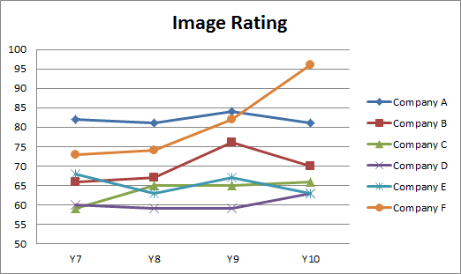
Image Rating - Kevin Trochez
Two factors for high Image rating: P/Q Rating & Global Market Share
Attracting more camera & drone buyers

Slide 5
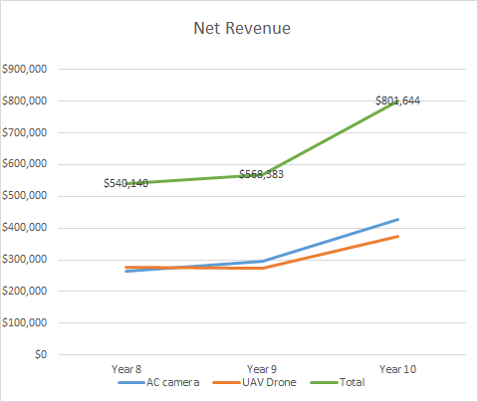
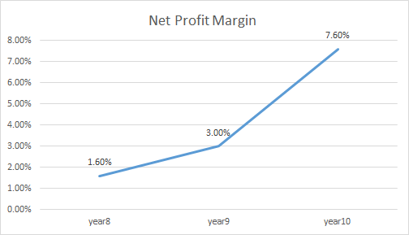
Net Profit Margin & Net Revenue - Binbin Xuan

Slide 6
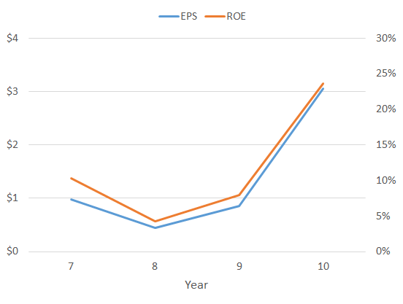
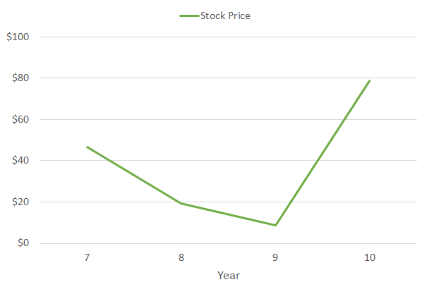
EPS, ROE, & Stock Price - Yun Ye

Slide 7
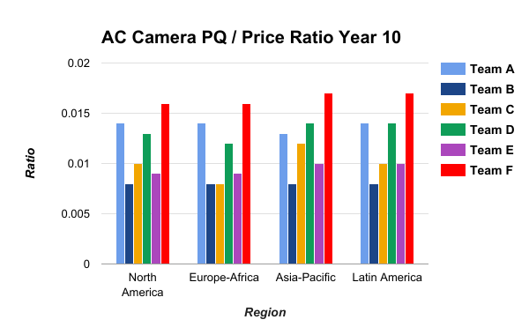
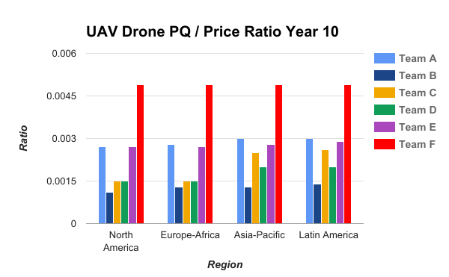
P/Q Rating & Price Year 10 - Gregory Szymanski

